Slide 1
Introduction to JS
04/08/2022 By Prachi Pandya

Slide 2
Agenda
What is JS?
Fundamentals of JS
JS functions
Coding style
Questions

Slide 3
JavaScript

Slide 4
What is JavaScript?
Cross-platform
Object-oriented scripting language
Used to make webpages interactive
Client-side JS
Place elements on an HTML form
Respond to user events such as mouse clicks, form input, and page navigation
User input validations
Example- Angular, React, Vue
Server-side JS
Application to communicate with a database
Perform file manipulations on a server
Create servers to receive data from firmware
Example- Node.js
Latest version- ES6

Slide 5
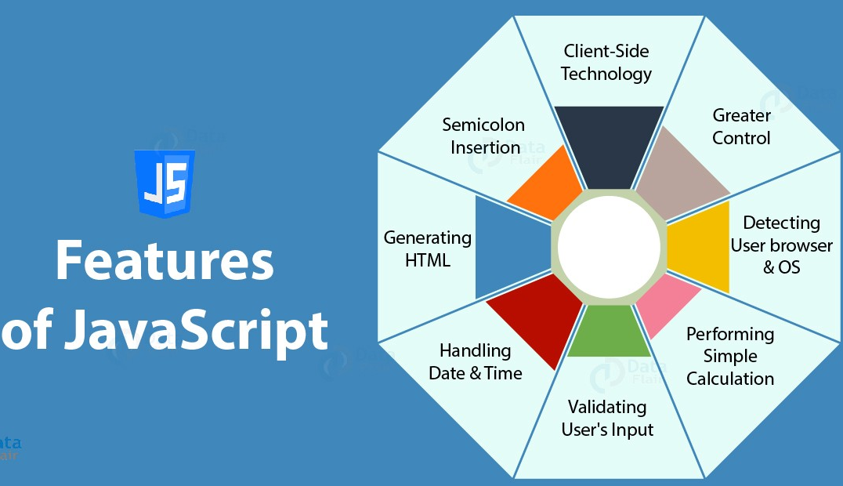
Notes:
Browser objects - https://www.w3schools.com/js/js_ex_browser.asp
window
navigator
screen
history
timing

Slide 6
Fundamentals of JS
Notes:
https://javascript.info/first-steps

Slide 7
Where to write JS code?
In .html file
In .js file
Browsers console
Any online JS code editors like JSFiddle

Slide 8
Code structure
Statements
Semicolons
Comments
Notes:
https://javascript.info/structure

Slide 9
“use strict”
Introduced in ECMAScript 5 (ES5)
Allows to use the latest updates of JS
Ensure that “user strict” is at the top else the strict mode may not be enabled
Notes:
https://javascript.info/structure

Slide 10
Basics of JS
Variable and its scope
Data types
Interaction: alert, confirmation, prompt
Type conversion
Basic operators
Comparisons
Conditions
Logical operators

Slide 11
Must know concepts
Scope
IIFE (Immediately Invoked Function Expression)
Hoisting
Closures
Callbacks
Promises
Async and await
Asynchronous
Event loop
Why is JS single-thread language?

Slide 12
JS Functions

Slide 13
Functions
Building blocks of the program
They allow code to be called many time without repetition
One function – One action
JS built-in functions
alert()
confirm()
prompt()
Custom functions
Function declaration
Function calling
Passing values and setting default values to functions
Returning a value

Slide 14
Functions naming convention
A name should clearly describe what the function does
A function is an action, so function names are usually verbal
Use camelCase
Examples
calcMarks
checkPermission
createFrom

Slide 15
Functions comments
Always have a short comment which describes the function’s work
If required add comment for the function logic as well

Slide 16
Different ways to call function
Function declaration
When the function is declared as a separate statement
Function expressions
When they are assigned to a variable
Function name is optional in expressions
Function as value
When a function is passed as argument in other function
NOTE: Amongst function declaration and expression, function declaration is preferable

Slide 17
Types of functions
Recurring functions
One which calls itself until the condition is satisfied
Arrow functions
A special type of function expression
They come in handy for one liner functions
//Multi-line with return
let sum = (number1, number2) => { let total = number1 + number2; return total; }
// Single line
let sum = (number1, number2) => number1 + number2;
// Single line and no parentheses
let double = n => n * 2;

Slide 18
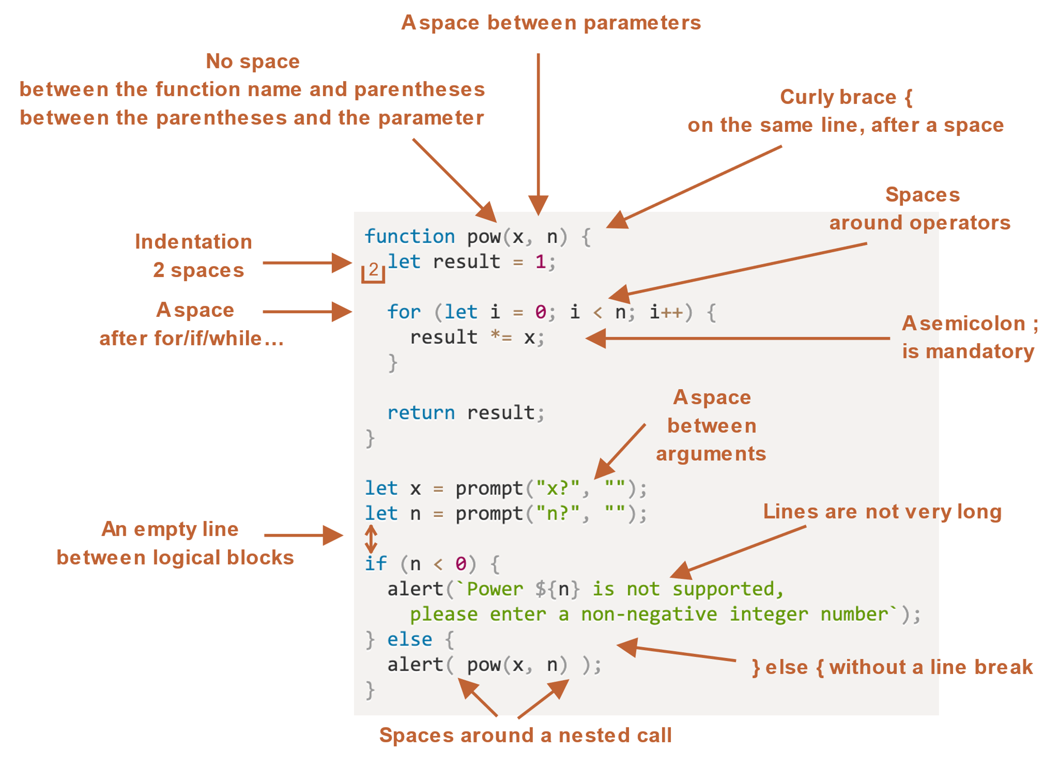
Coding style

Slide 19
Questions?

